Slide 1







Project DITEAM12
Diverse and Inclusive teams for children under 12
Understanding inclusion

Slide 2
Understanding inclusion
Aims
Consider concepts of inclusion, exclusion & difference;
Apply simple frameworks of inclusion and adaptation tools

Slide 3
Understanding inclusion
Learning
Outcomes
Learners will:
understand the use of easy-to -apply tools enabling them to create more inclusive practice in their own settings (home, school or sports session).

Slide 4

Understanding inclusion istockphoto
The concept of inclusion means different things to different people.
Being ‘one of the gang’.
Access to opportunity
A fair society

Slide 5
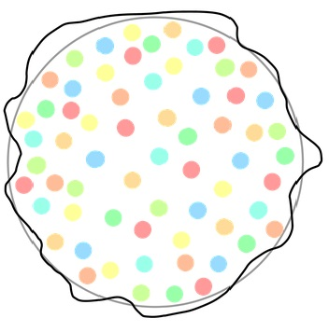
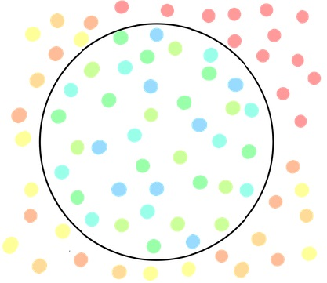
Understanding inclusion-exclusion maxpixel.net
Exercise
Think about times from your own experience when you have felt included and excluded.
Contrast the feelings you have when you are included compared to when you feel excluded.

Slide 6

Difference spectrumadvisors.ca
What does difference mean to you?
  Is it:
  always positive;
  always negative?
Why do we sometimes fear difference?
Diversity – celebrating difference!

Slide 7

What is inclusion to you?
Brainstorm inclusion – everything you think that it is. pinclipart
Inclusion is feeling that:
you are welcome
you are involved
you’re respected and valued
you have a choice
you have access to opportunity
there is information available
people are listening to you.

Slide 8

Inclusion principles
A social approach to inclusion
A wider interpretation supporting different individuals in different ways
Creating an inclusion environment – not just physical access, but also attitudinal, institutional and societal
Focus on ability and aspiration

Slide 9
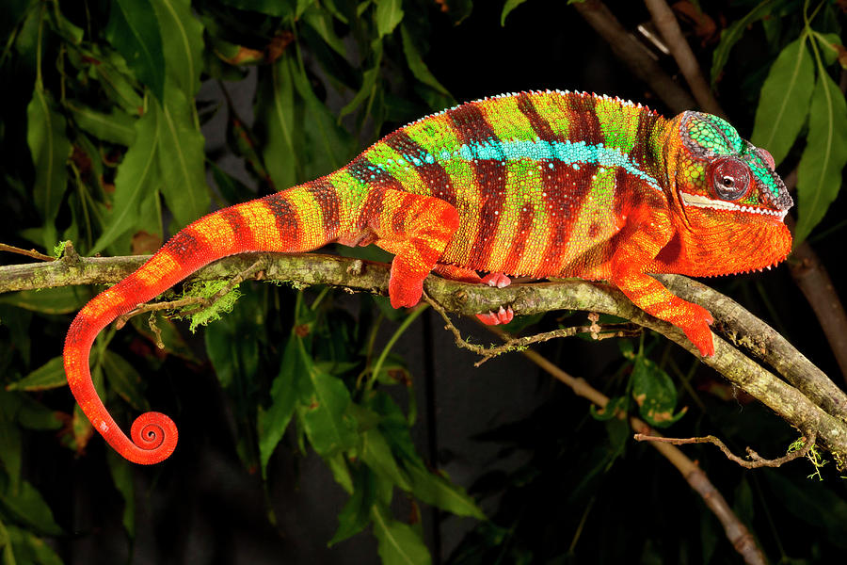
Adaptation
David Northcott
Applying a social/environmental approach to inclusion
Emphasis on the actions of the teacher/coach/parent/volunteer and not a reaction to an individual’s impairment
Focus on the factors that you can control and less on those that you cannot.

Slide 10
The STEP adaptation tool
  Changes to the:
  Space
  Task
  Equipment
  People
Enables the participation together of:
children and young people of different ages
disabled and non-disabled young people
different genders.

Slide 11
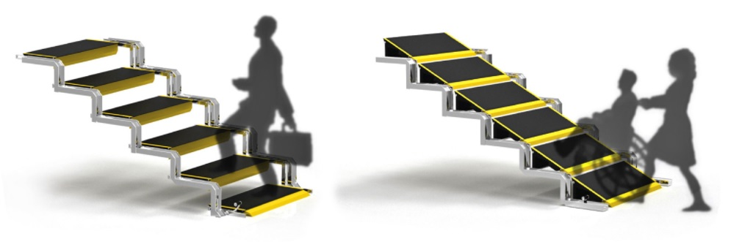
The STEP adaptation tool
Space
Task
Equipment
People
Concept: Chan Wen Jie
Space
The playing space, the space between players or the distance to targets can altered to suit individual abilities.
Task
The way in which young people perform skills can be simplified to support understanding, or made more complex to challenge and extend.
Equipment
Equipment can be modified or specifically-designed to address needs; or regular equipment can be used in a modified way.
People
The relationship between players, including specific roles within an activity, group organisation or team numbers can all be amended to support inclusion.

Slide 12
STEP Examples
Space | increase or decrease the size of the playing area; vary the distance to be covered in practices to suit different abilities or mobility levels; use zoning, for example, where players are matched by ability and therefore have more opportunity to participate.
Task | ensure that everyone has equal opportunity to participate, e.g. in a ball game, all the players have the chance to carry/dribble, pass or shoot; break down complex skills into smaller component parts if this helps players to more easily develop skills; ensure there is adequate opportunity for players to practice skills or components individually or with a partner before being included in a small-sided team game; add or remove a time limit to challenge skilful players or support those still developing their skills.
Equipment | in ball games, increase or decrease the size of the ball to suit the ability or age range of the players, or depending on the kind of skill being practiced; provide options that enable people to send or receive a ball in different ways, for example, using a chute or gutter to send, a catching mitt to receive; the use of bell or rattle balls can assist some players to track or follow the movement of the ball.
People | match players of similar ability in small-sided or close marking activities; balance team numbers according to the overall ability of the group, i.e. it may be preferable to play with teams of unequal numbers to facilitate inclusion of some players and maximise participation of others; give players a specific role in a game that emphasises their abilities.

Slide 13
Exercise
Exercise
Apply the STEP adaptation tool to a specific activity.
Think about a sport or activity – or maybe one specific component of skill development.
Using the STEP matrix as a guide, think of ways in which you can use the STEP adaptation tool to develop alternatives that will enable the inclusion of a wider range of abilities.
Your activity/sport:
STEP component | Adaptations
Space
Task
Equipment
People

Slide 14
The Inclusion Spectrum incorporating STEP
The Inclusion Spectrum is:
a framework for inclusive practice
effective across a wide range of abilities and almost every activity
supports a social/environmental approach to inclusion (i.e. focus on the actions of the practitioner).

Slide 15
The Inclusion Spectrum incorporating STEP
(Black/Stevenson 2011-12)

Slide 16

How does the Inclusion Spectrum work?
By presenting activities differently we can balance different
needs within a group and help to maximise the potential of all
young people.
The Inclusion Spectrum (incorporating STEP) helps practitioners
working with young disabled people in physical education and
sport to represent the social/environmental interpretation of
disability and inclusion in practical situations.

Slide 17
Open activities
Everyone can play
Everyone does the same activity with minimal or no adaptations to the environment or equipment; open activities are by their nature inclusive so that the activity suits every participant.
For example, warm-up or cool down, and cooperative or unstructured movement games (like collecting games, play canopy games, or action songs and activities).

Slide 18
Modified activities
Change to include
Everyone plays the same game or performs the same activity but the rules, equipment or playing space are adapted to promote the inclusion of all individuals regardless of their abilities.
For example, playing basketball with a variety of targets, such as the regulation basket, a hoop taped to the wall and a floor target (or similar, such as a box on the floor) so that participants choose to score in the target most suited to their abilities. Or balance an activity between mobility-impaired and non-disabled participants by restricting the space available to the agile partner.

Slide 19
Parallel activities
Ability groups
In this approach, although participants follow a common activity theme, they do so at their own pace and level by working in groups based on their abilities.
For example, two groups can play a seated and standing version of a game where participants access the version most suited to their abilities. Or in a net-wall game (like volleyball) participants, in three groups, play with no barrier, a low net, or a net at regulation height.
One consideration in the parallel approach is that abilities can change dependent upon the activity; for example, someone who is confident playing a complex version of a racket sport may move to a less challenging group if the activity switches to a game based on football or rugby.

Slide 20
Separate or alternate activities
This approach emphasises that, on occasions, it may be better for a young person to practice sports individually or with their disabled peers.
For example, it may be more effective to withdraw an individual (not necessarily a disabled participant) in order to practice individual physical education and sports competencies to enable successful integration at a later stage into a game situation with the rest of the group.
Or athletes may need to train separately with peers to prepare for a competition. An example of this would be a wheelchair-basketball group included in a local basketball club, or girls-only football group training for competition.

Slide 21
Disability sport
Adapted physical activity
This is ‘reverse integration’ where non-disabled young people are included in disability sports together with disabled peers; for example, using the Paralympic sports of goalball, boccia, or sitting volleyball as a basis for an inclusive game.
Reverse integration sessions improve attitudes towards disability sports and raise the self-esteem of disabled participants who may have proficiency in these activities.

Slide 22
Exercise
Using the information and suggestions shown above, select two of the
Inclusion Spectrum approaches and show how you can use them to create
an inclusive version of any specific activity.
For example, in a Parallel activity, show three different versions of the same
activity that will accommodate young people working at different levels of
ability.

Slide 23
Rationale
The main objective behind the development of the Inclusion Spectrum framework and STEP adaptation tool (note that other similar models exist) is to create a sports landscape that welcomes and accepts difference and actively works to find positive ways to include everyone in physical activity, maximising participation.

Slide 24
Sources/resources
IOC (2019) ‘Sport Values in Every Classroom’ toolkit. Olympic World Library - Sport values in every classroom : teaching respect, equity and inclusion to 8-12 year-old students / UNESCO - Detail (olympics.com)
Mike Oliver (2013) The social model of disability: thirty years on, Disability & Society, 28:7, 1024-1026, DOI: 10.1080/09687599.2013.818773
Black, Ken (2011) Coaching disabled children. In Stafford, Ian (ed.) Coaching Children in Sport. London: Routledge
Black, K. and Williamson, D. (2011) Designing inclusive physical activities and games. In A. Cereijo-Roibas, E. Stamatakis and K. Black (eds), Design for sport. Farnham, UK: Gower
Stevenson, P. (2009) The pedagogy of inclusive youth sport: working towards real solutions. In H. Fitzgerald (ed.), Disability and youth sport. London: Routledge
The Inclusion Club – www.theinclusionclub.com – ‘Episodes’ tab, Episode 17

