Slide 1
Project DITEAM12
Diverse and Inclusive teams for children under 12
Understanding disability

Slide 2
Understanding disability Aims
Explore the myths and realities of disability
Understand the meaning of disability, impairment and factors affecting the lived experiences of disabled people;
Understand the application of models and frameworks of disability in relation to physical activity and sport.

Slide 3
Understanding disability Learning Outcomes
Learners will:
have an understanding of basic issues associated with disability;
understand how these issues have implications for physical activity and sport and their contribution towards the creation of a fair society for all.

Slide 4
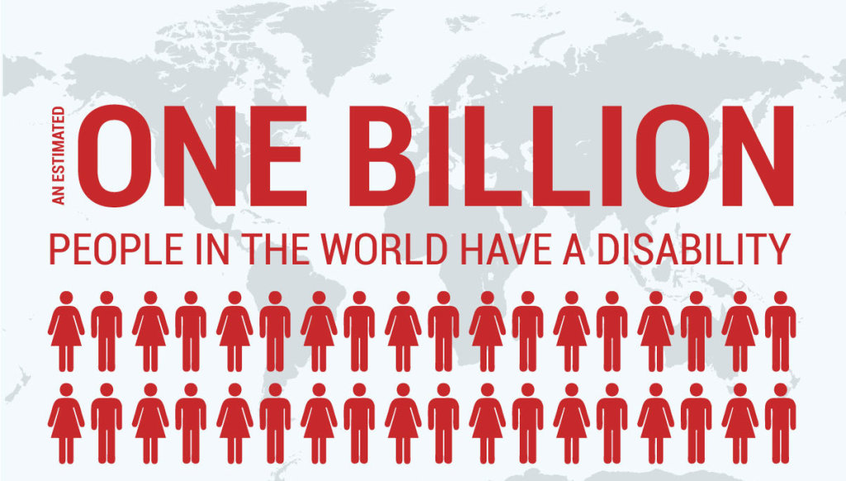
Understanding disability Numbers
It is estimated that there are 1 billion disabled people in the world – just less than one in seven of every human being on the planet.
In most developed countries, between 15-20% of the population have impairments.
The prevalence of impairments and their severity increases with age.

Slide 5
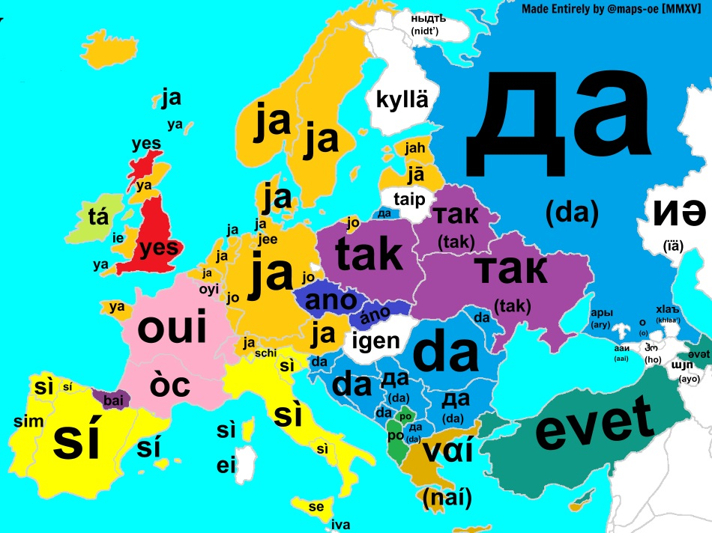
Understanding disability Words
The terminology of disability and impairment varies around the world.
‘Disabled people’ or ‘people with disabilities’?
Practical solutions:
use the expressions favoured where YOU are
avoid unhelpful negative stereotypes
USE PEOPLE’S NAMES!

Slide 6
Understanding disability Definitions
Exercise
What does the word ‘disability’ mean to you? Brainstorm and list all the words you know.
What is it that ‘disables’ people? Is it their impairments – or other factors?
Medical model of disability
people disabled by their impairments
Social model of disability
people disabled by societal factors, such as environment, attitudes, barriers to opportunity

Slide 7
Models of disability
Impairment-centred
Medical profession
Assessment
Benefit agencies
Therapy
Segregated education
'Sheltered'
employment
Society-focused
Individual control of needs
Access to information
Disabled people as tax-payers
Accessible environment
Inclusive education
Supported 'open' employment

Slide 8
Interpretation
‘In our view it is society which disables physically impaired people. Disability is something imposed on top of our impairments by the way we are unnecessarily isolated and excluded from full participation in society.’
Union of the Physically Impaired Against Segregation (UPIAS)
1976
‘ … disability should be viewed neither as purely medical nor as purely social: persons with disabilities can often experience problems arising from their health condition. A balanced approach is needed, giving appropriate weight to the different aspects of disability.’
World Health Organisation (WHO)
2011

Slide 9
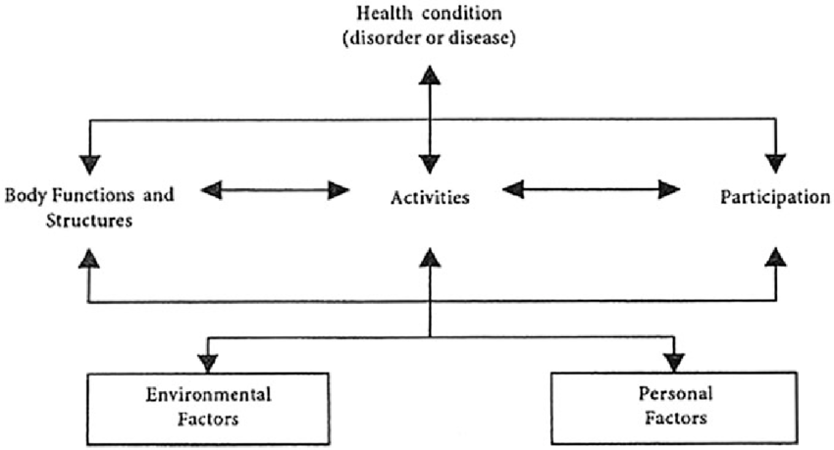
International Classification of Functioning, Disability & Health (ICF)
World Health Organisation
The ICF says:
There are a range of different factors affecting the lives of people who have impairments.
The effect of an impairment on any individual depends upon the different influences of these factors.
For example, a person who has a mobility impairment could function effectively in a postal sorting office but less so as a postman.

Slide 10
Summarising definition
The definition of disability can be seen in this way:
Impairment – is what the person has – physical, sensory or intellectual, or a medical condition (like multiple sclerosis).
Disability – is the disabling effect of societal barriers (for example, attitudes, lack of opportunity) together with other environmental, personal and health factors.
NOTE: impairments do not necessarily indicate poor health. Many people have impairments but are not ‘ill’, in pain or in a reduced health situation.

Slide 11
The Sport Model designbolts
Classification or grouping of athletes is a common feature of almost all sport; for example, age, gender or weight divisions.
In disability sport, in order to classify or categorise athletes and provide a structure for competition, the focus is on their functional ability.
Athletes are grouped in functional ‘bands’ (classification groups) in order to compete against peers of similar functional ability.

Slide 12
The Sport Model
Other disability sport programmes use other methods of grouping athletes for competition.
For example, in Special Olympics, competitors are grouped in performance bands (called ‘divisioning’); for example, all those taking the same or similar time to complete 100m track will race together.

Slide 13
The start point Vector stock
If we apply a social model or ICF approach to physical activity, then this places the focus not upon the disabled person but on the teacher, coach, parent or volunteer.
The emphasis on the actions of the teacher, coach, parent or volunteer and not on reactions to whatever impairment a person presents.

Slide 14
Exercise: what you can control
When working with disabled children and adults in sport, over which of the factors opposite do you have control, and over which do you have less or no control?
Group organisation Analysis
Communication Confidence
The impairment Adapted equipment
Planning Observation
Knowledge Enthusiasm
Leadership Disability knowledge

Slide 15
The start point You have control over almost all of these factors! In fact, the only factor over which you have no control is the person’s impairment. Everything else is in your power. Vector stock
You can learn how to modify and adapt equipment or use regular equipment differently.
You try to find out about all your athletes’ idiosyncrasies and differences – this includes their impairments and the implications for sport and physical activity.
Your confidence will improve with time and experience.

Slide 16
The start point Vector stock
Therefore, as a teacher, coach, parent or volunteer concentrate on the things over which you have control and do not worry so much about those aspects over which you do not have control.
This is the start point: what you can do and not what an individual cannot do.

Slide 17
Sources/references
Banks et al, (2010). Financial circumstances, health and well-being of the older population in England. The 2008 English Longitudinal Study of Ageing. London: IFS.
Life Opportunities Survey 2009-2012 / Census 2011
Sport England (2016). ‘Mapping Disability: the facts – A statistical review of disabled people in England’
World Health Organisation, International Classification of Functioning, Disability and Health (ICF) (who.int)
World Health Organisation & World Bank (2011). ‘World report on Disability’.
Union of the Physically Impaired Against Segregation (UPIAS) (1976). ‘Fundamental Principles’ (booklet)

